Slide 1

Computational Models for Social Network Analysis
—mining big social networks
Jie Tang
Computer Science, Tsinghua University
@WWW’2017

Slide 2



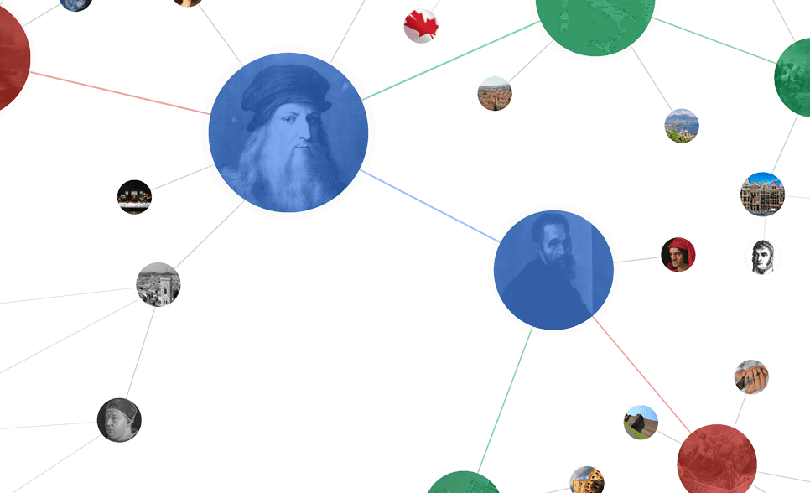




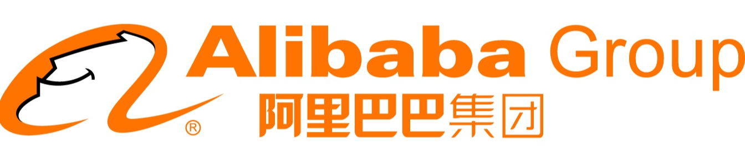
Networked World
1.65 billion MAU
2.5 trillion minutes/month
QQ: 800 million MAU
WeChat: 700 million MAU
255 million MAU
Peak: 143K tweets/s
220 million users
influencing our daily life
304 million active users
14 billion items/year
~700 million trans. (alipay)
120.7 billion on 11/11
Notes:
http://www.digitaltrends.com/social-media/facebook-users-50-minutes/#:Tt28J4FGJlT5fA

Slide 3
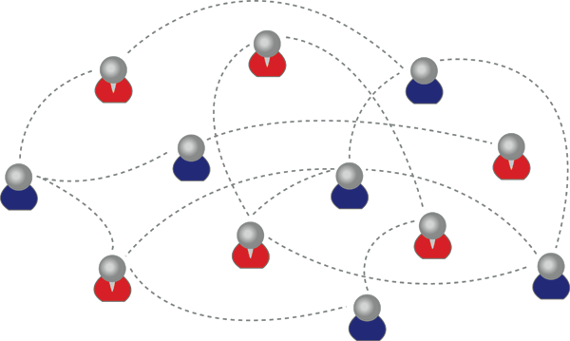
What is a social network?
A social network is:
  a graph made up of :
  a set of individuals, called “nodes”, and
  tied by one or more interdependency, such as friendship, called “edges”.
Notes:
@CCDM 2016

Slide 4
So, that is Social Network?
To understand it, we need to trace back…

Slide 5

15-20 years before…
Web = Information Space
-
?
+
?
+
?
-
-
+
0.99
0.99
hyperlinks between web pages
Examples:
Google’s PageRank
Kleinberg’s HITS
0.80
… …
0.01
[1] L. Page, S. Brin, R. Motwani, & T. Winograd. (1999). The pagerank citation ranking: bringing order to the web. Stanford University.
[2] J. M. Kleinberg. Authoritative sources in a hyperlinked environment. Journal of the ACM (JACM) 46.5 (1999): 604-632.

Slide 6

10 years before…
Collaborative Web = Info Space + Users
Interaction
Personalized recommendation
Collaborative Filtering
[1] P. Resnick, N. Iacovou, M. Suchak, P. Bergstrom, & J. Riedl. (1994). GroupLens: an open architecture for collaborative filtering of netnews. CSCW'94. ACM, New York, NY, USA, 175-186.

Slide 7
Recent 5-10 years…
Social Network = Info. Space + Social Space
Info. Space
Information
Knowledge
Intelligence
Social Space
Interaction
[1] J. Scott. (1991, 2000, 2012). Social network analysis: A handbook.
[2] D. Easley and J. Kleinberg. Networks, crowds, and markets: Reasoning about a highly connected world. Cambridge University Press, 2010.

Slide 8
How about research for Social Network?
Computational Models
Big Data Algorithms
Sociology, Physics, Psychology, Business, Management, et al.
Interdisciplinary

Slide 9
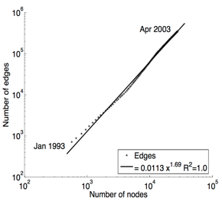
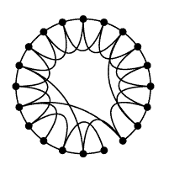
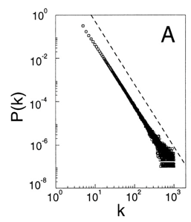
History of Social Network Analysis
Computational Social Science [Giles]
2012
Computational Social Science [Lazer et al.]
2009
2009
Social Influence Analysis [Tang, Sun]
2007
Spread of Obesity, Happiness [Christakis, Fowler]
2005
Densification [Leskovec, Kleinberg, Faloutsos]
2003
Link Prediction [Liben-Nowell, Kleinberg]
Influence Maximization [Kempe, Kleinberg, Tardos]
2002
Community Detection [Girvan, Newman]
Scale Free [Barabási, Albert & Faloutsos et al.]
1999
Small World [Watts, Strogatz]
1998
HITS [Kleinberg]&PageRank [Brin&Page]
1997
1995
Structural Hole [Burt]
1992
Dunbar’s Number [Dunbar]
1973
Weak Tie [Granovetter]
1967
Six Degrees of Separation [Milgram]
Notes:
Social influence
Information diffusions
1955, Two step of flow: katz lazarsfeld

Slide 10
History of Social Network Analysis
Stanley Milgram. The small world problem. Psychology Today, 2(1):60–67, 1967.
1967: Six Degrees of Separation
“Given two individuals selected randomly from the population, what is the probability that the minimum number of intermediaries required to link them is 0, 1, 2, …, k?”
Milgram “selected 296 volunteers and to distribute a mail to a stockholder living in Boston.”
“The average number of intermediaries in the mailing chains was 5.2.”
Computational Social Science [Giles]
2012
Computational Social Science [Lazer et al.]
2009
Spread of Obesity, Smoking, Happiness
[Christakis, Fowler]
2008
2007
2005
Densification [Leskovec, Kleinberg, Faloutsos]
2003
Link Prediction [Liben-Nowell, Kleinberg]
Influence Maximization [Kempe,Kleinberg,Tardos]
2002
Community Detection [Girvan, Newman]
Scale Free [Barabási,Albert & Faloutsos et al.]
1999
Small World [Watts, Strogatz]
1998
Hubs & Authorities [Kleinberg]
1997
Stanley Milgram. The small world problem. Psychology Today, 2(1):60–67, 1967. Cited by 6967 (as of May 2016)
1995
Structural Hole [Burt]
1992
Dunbar’s Number [Dunbar]
1973
Weak Tie [Granovetter]
1967
Six Degrees of Separation [Milgram]
Notes:
Social influence
Information diffusions
1955, Two step of flow: katz lazarsfeld

Slide 11
History of Social Network Analysis
Stanley Milgram. The small world problem. Psychology Today, 2(1):60–67, 1967.
1973: Weak Tie
The weak tie hypothesis argues, if A is linked to both B and C, then there is a greater-than-chance probability that B and C are linked to each other.
Essentially form “A friend’s friend is also my friend”
Computational Social Science [Giles]
2012
Computational Social Science [Lazer et al.]
2009
Spread of Obesity, Smoking, Happiness
[Christakis, Fowler]
2008
2007
2005
Densification [Leskovec, Kleinberg, Faloutsos]
2003
Link Prediction [Liben-Nowell, Kleinberg]
Influence Maximization [Kempe,Kleinberg,Tardos]
2002
Community Detection [Girvan, Newman]
Scale Free [Barabási,Albert & Faloutsos et al.]
1999
Small World [Watts, Strogatz]
1998
Granovetter, Mark S. The strength of weak ties. American journal of sociology 78.6 (1973): 1360-1380. Cited by 43186 (as of April 2017)
Hubs & Authorities [Kleinberg]
1997
1995
Structural Hole [Burt]
1992
Dunbar’s Number [Dunbar]
1973
Weak Tie [Granovetter]
1967
Six Degrees of Separation [Milgram]
Notes:
Social influence
Information diffusions
1955, Two step of flow: katz lazarsfeld

Slide 12
History of Social Network Analysis
Stanley Milgram. The small world problem. Psychology Today, 2(1):60–67, 1967.
1992: Dunbar’s Number
“Dunbar‘s number is a suggested cognitive limit to the number of people with whom one can maintain stable social relationships.”
Dunbar “proposed that humans can only comfortably maintain 150 stable relationships.”
Computational Social Science [Giles]
2012
Computational Social Science [Lazer et al.]
2009
Spread of Obesity, Smoking, Happiness
[Christakis, Fowler]
2008
2007
2005
Densification [Leskovec, Kleinberg, Faloutsos]
2003
Link Prediction [Liben-Nowell, Kleinberg]
Influence Maximization [Kempe,Kleinberg,Tardos]
2002
Community Detection [Girvan, Newman]
Scale Free [Barabási,Albert & Faloutsos et al.]
1999
Small World [Watts, Strogatz]
1998
Robin I. M. Dunbar. Neocortex size as a constraint on group size in primates. Journal of Human Evolution 22 (6): 469–493. Cited by 1393 (as of May 2016)
Hubs & Authorities [Kleinberg]
1997
1995
Structural Hole [Burt]
1992
Dunbar’s Number [Dunbar]
1973
Weak Tie [Granovetter]
1967
Six Degrees of Separation [Milgram]
Notes:
Social influence
Information diffusions
1955, Two step of flow: katz lazarsfeld

Slide 13
History of Social Network Analysis
Stanley Milgram. The small world problem. Psychology Today, 2(1):60–67, 1967.
1995: Structural Holes
“The position of a bridge between distinct groups allows him or her to transfer valuable information from one group to another.”
“The individual can combine all the ideas he or she receives from different sources and come up with the most innovative idea among all.”
Computational Social Science [Giles]
2012
Computational Social Science [Lazer et al.]
2009
Spread of Obesity, Smoking, Happiness
[Christakis, Fowler]
2008
2007
2005
Densification [Leskovec, Kleinberg, Faloutsos]
2003
Link Prediction [Liben-Nowell, Kleinberg]
Influence Maximization [Kempe,Kleinberg,Tardos]
2002
Community Detection [Girvan, Newman]
Scale Free [Barabási,Albert & Faloutsos et al.]
1999
Small World [Watts, Strogatz]
1998
Ronald S. Burt. Structural Holes: The Social Structure of Competition. Cambridge: Harvard University Press. 1995. Cited by 20207 (as of May 2016)
Hubs & Authorities [Kleinberg]
1997
1995
Structural Hole [Burt]
1992
Dunbar’s Number [Dunbar]
1973
Weak Tie [Granovetter]
1967
Six Degrees of Separation [Milgram]
Notes:
Social influence
Information diffusions
1955, Two step of flow: katz lazarsfeld

Slide 14
History of Social Network Analysis
Stanley Milgram. The small world problem. Psychology Today, 2(1):60–67, 1967.
Computational Social Science [Giles]
2012
The 20th Century:
Sociology & Anthropology
Computational Social Science [Lazer et al.]
2009
Spread of Obesity, Smoking, Happiness
[Christakis, Fowler]
2008
2007
2005
Densification [Leskovec, Kleinberg, Faloutsos]
2003
Link Prediction [Liben-Nowell, Kleinberg]
Influence Maximization [Kempe,Kleinberg,Tardos]
2002
Community Detection [Girvan, Newman]
Scale Free [Barabási,Albert & Faloutsos et al.]
1999
Small World [Watts, Strogatz]
1998
Hubs & Authorities [Kleinberg]
1997
1995
Structural Hole [Burt]
1992
Dunbar’s Number [Dunbar]
1973
Weak Tie [Granovetter]
1967
Six Degrees of Separation [Milgram]
Notes:
Social influence
Information diffusions
1955, Two step of flow: katz lazarsfeld

Slide 15
History of Social Network Analysis
Stanley Milgram. The small world problem. Psychology Today, 2(1):60–67, 1967.
1997-1998: HITS and PageRank
Computational Social Science [Giles]
2012
Computational Social Science [Lazer et al.]
2009
Spread of Obesity, Smoking, Happiness
[Christakis, Fowler]
2008
2007
2005
Densification [Leskovec, Kleinberg, Faloutsos]
2003
Link Prediction [Liben-Nowell, Kleinberg]
Influence Maximization [Kempe,Kleinberg,Tardos]
2002
Community Detection [Girvan, Newman]
Scale Free [Barabási,Albert & Faloutsos et al.]
1999
Small World [Watts, Strogatz]
1998
HITS [Kleinberg]&PageRank [Brin&Page]
1997
Stanley Milgram. The small world problem. Psychology Today, 2(1):60–67, 1967.
1995
Structural Hole [Burt]
1. Jon M. Kleinberg. Authoritative sources in a hyperlinked environment. In ACM SODA, 1998. Extended version in Journal of the ACM 46 (1999). Also at IBM Research Report RJ 10076, May 1997. Cited by 9896 (as of May 2016)
2. Sergey Brin, Lawrence Page. The anatomy of a large-scale hypertextual Web search engine. In WWW’07, Pages 107-117,1998. Cited by 14618 (as of May 2016)
1992
Dunbar’s Number [Dunbar]
1973
Weak Tie [Granovetter]
1967
Six Degrees of Separation [Milgram]
Notes:
Social influence
Information diffusions
1955, Two step of flow: katz lazarsfeld

Slide 16
History of Social Network Analysis
Stanley Milgram. The small world problem. Psychology Today, 2(1):60–67, 1967.
1998: Small World
Computational Social Science [Giles]
2012
Small-World Properties:
1. short average path lengths
2. high clustering coefficients
Computational Social Science [Lazer et al.]
2009
Spread of Obesity, Smoking, Happiness
[Christakis, Fowler]
2008
2007
2005
Densification [Leskovec, Kleinberg, Faloutsos]
2003
Link Prediction [Liben-Nowell, Kleinberg]
Influence Maximization [Kempe,Kleinberg,Tardos]
2002
Community Detection [Girvan, Newman]
Scale Free [Barabási,Albert & Faloutsos et al.]
1999
Small World [Watts, Strogatz]
1998
HITS [Kleinberg]&PageRank [Brin&Page]
1997
Stanley Milgram. The small world problem. Psychology Today, 2(1):60–67, 1967.
1995
Structural Hole [Burt]
Duncan Watts, Steven Strogatz. Collective dynamics of ‘small-world’ networks. Nature 393 (6684): 440–442. Cited by 29044 (as of May 2016)
1992
Dunbar’s Number [Dunbar]
1973
Weak Tie [Granovetter]
1967
Six Degrees of Separation [Milgram]
Notes:
Social influence
Information diffusions
1955, Two step of flow: katz lazarsfeld

Slide 17
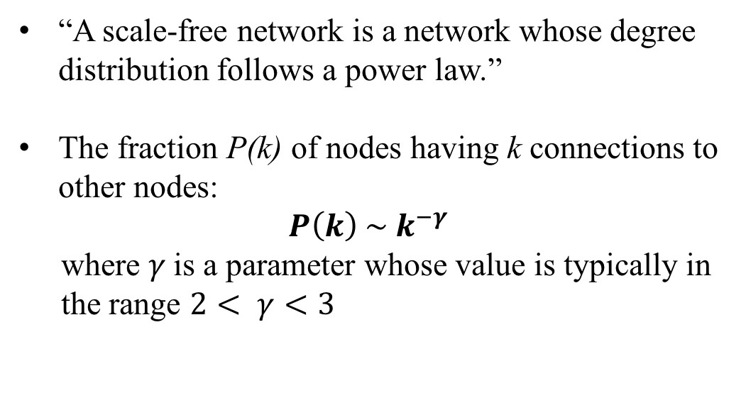
History of Social Network Analysis
Stanley Milgram. The small world problem. Psychology Today, 2(1):60–67, 1967.
1999: Scale Free
“A scale-free network is a network whose degree distribution follows a power law.”
The fraction P(k) of nodes having k connections to other nodes:
$$P\left(k\right) \sim k^{−γ}$$
where $γ$is a parameter whose value is typically in the range $2< γ<3$
Computational Social Science [Giles]
2012
Computational Social Science [Lazer et al.]
2009
Spread of Obesity, Smoking, Happiness
[Christakis, Fowler]
2008
2007
2005
Densification [Leskovec, Kleinberg, Faloutsos]
2003
Link Prediction [Liben-Nowell, Kleinberg]
Influence Maximization [Kempe,Kleinberg,Tardos]
2002
Community Detection [Girvan, Newman]
Scale Free [Barabási,Albert & Faloutsos et al.]
1999
Small World [Watts, Strogatz]
1998
HITS [Kleinberg]&PageRank [Brin&Page]
1997
Stanley Milgram. The small world problem. Psychology Today, 2(1):60–67, 1967.
1995
Structural Hole [Burt]
Albert-László Barabási, Réka Albert. Emergence of scaling in random networks, Science, 286:509–512, 1999. Cited by 25189 (as of May 2016)
Michalis Faloutsos, Petros Faloutsos, Christos Faloutsos. On power-law relationships of the internet topology. In ACM SIGCOMM 1999. Cited by 5631 (as of May 2016)
1992
Dunbar’s Number [Dunbar]
1973
Weak Tie [Granovetter]
1967
Six Degrees of Separation [Milgram]
Notes:
Social influence
Information diffusions
1955, Two step of flow: katz lazarsfeld

Slide 18
History of Social Network Analysis
Stanley Milgram. The small world problem. Psychology Today, 2(1):60–67, 1967.
The Late 20th Century:
Computer Science & Physics & Mathematics
Computational Social Science [Giles]
2012
Computational Social Science [Lazer et al.]
2009
Spread of Obesity, Smoking, Happiness
[Christakis, Fowler]
2008
2007
2005
Densification [Leskovec, Kleinberg, Faloutsos]
2003
Link Prediction [Liben-Nowell, Kleinberg]
Influence Maximization [Kempe,Kleinberg,Tardos]
2002
Community Detection [Girvan, Newman]
Scale Free [Barabási,Albert & Faloutsos et al.]
1999
Small World [Watts, Strogatz]
1998
Hubs & Authorities [Kleinberg]
1997
1995
Structural Hole [Burt]
1992
Dunbar’s Number [Dunbar]
1973
Weak Tie [Granovetter]
1967
Six Degrees of Separation [Milgram]
Stanley Milgram. The small world problem. Psychology Today, 2(1):60–67, 1967.
The 20th Century: Sociology & Anthropology
Notes:
Social influence
Information diffusions
1955, Two step of flow: katz lazarsfeld

Slide 19
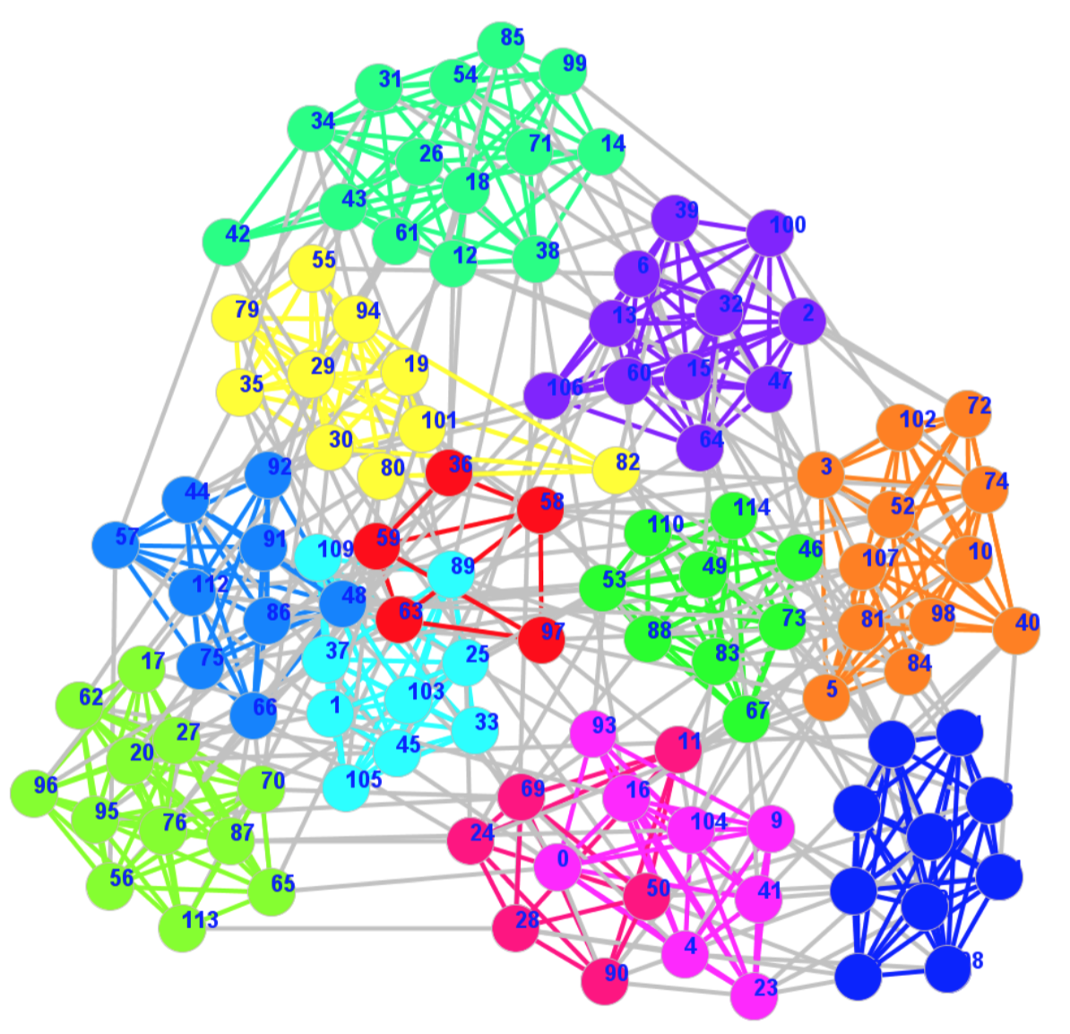
History of Social Network Analysis
Stanley Milgram. The small world problem. Psychology Today, 2(1):60–67, 1967.
2002: Community Detection
“The property of community structure, in which network nodes are joined together in tightly knit groups, between which there are only looser connections.”
Computational Social Science [Giles]
2012
M. Girvan and M. E. J. Newman. Community structure in social and biological networks. PNAS 99(12):7821-7826, 2002. Cited by 8088 (as of May 2016)
Computational Social Science [Lazer et al.]
2009
2009
Social Influence Analysis [Tang, Sun]
2007
Spread of Obesity, Happiness [Christakis, Fowler]
2005
Densification [Leskovec, Kleinberg, Faloutsos]
2003
Link Prediction [Liben-Nowell, Kleinberg]
Influence Maximization [Kempe, Kleinberg, Tardos]
2002
Community Detection [Girvan, Newman]
Stanley Milgram. The small world problem. Psychology Today, 2(1):60–67, 1967.
Scale Free [Barabási,Albert & Faloutsos et al.]
1999
Small World [Watts, Strogatz]
1998
Hubs & Authorities [Kleinberg]
1997
1995
Structural Hole [Burt]
1992
Dunbar’s Number [Dunbar]
1973
Weak Tie [Granovetter]
1967
Six Degrees of Separation [Milgram]
Notes:
Social influence
Information diffusions
1955, Two step of flow: katz lazarsfeld

Slide 20
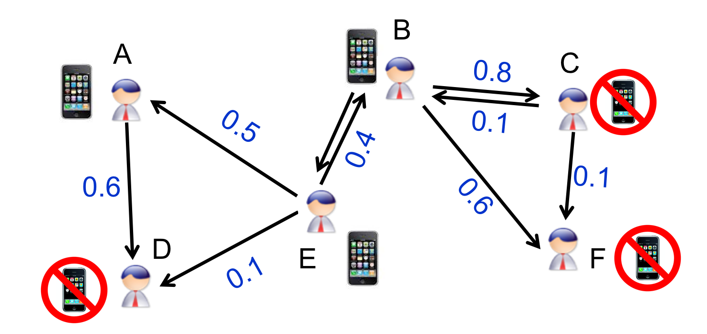
History of Social Network Analysis
2003: Influence Maximization
    Minimize marketing cost and more generally to maximize profit, e.g., to get a small number of influential users to adopt a new product, and subsequently trigger a large cascade of further adoptions.
Computational Social Science [Giles]
2012
D. Kempe, J. Kleinberg, E. Tardos. Maximizing the Spread of Influence through a Social Network. In ACM KDD 2003. Best Research Paper Award & Test of Time Paper Award. Cited by 3513 (as of May 2016)
Computational Social Science [Lazer et al.]
2009
2009
Social Influence Analysis [Tang, Sun]
2007
Spread of Obesity, Happiness [Christakis, Fowler]
2005
Densification [Leskovec, Kleinberg, Faloutsos]
2003
Link Prediction [Liben-Nowell, Kleinberg]
Influence Maximization [Kempe, Kleinberg, Tardos]
2002
Community Detection [Girvan, Newman]
Stanley Milgram. The small world problem. Psychology Today, 2(1):60–67, 1967.
Scale Free [Barabási,Albert & Faloutsos et al.]
1999
Small World [Watts, Strogatz]
1998
Hubs & Authorities [Kleinberg]
1997
1995
Structural Hole [Burt]
1992
Dunbar’s Number [Dunbar]
1973
Weak Tie [Granovetter]
1967
Six Degrees of Separation [Milgram]
Notes:
Social influence
Information diffusions
1955, Two step of flow: katz lazarsfeld

Slide 21
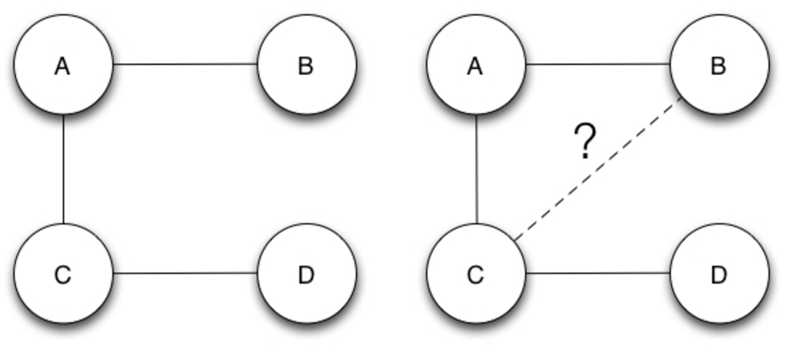
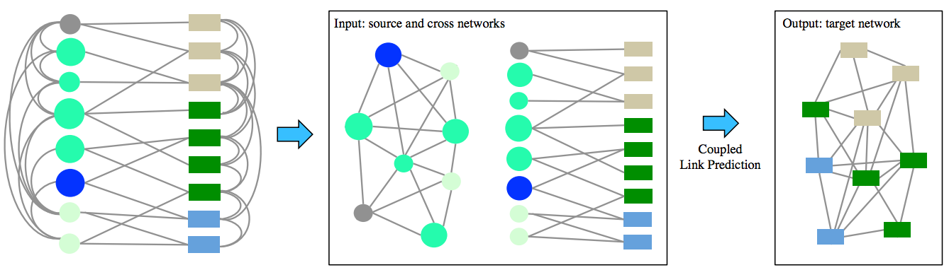
History of Social Network Analysis
Stanley Milgram. The small world problem. Psychology Today, 2(1):60–67, 1967.
2003: Link Prediction
“Given a snapshot of a social network at time t, we seek to accurately predict the edges that will be added to the network during the interval from time t to a given future time t’ .”
Computational Social Science [Giles]
2012
D. Liben-Nowell, J. Kleinberg. The Link Prediction Problem for Social Networks. In ACM CIKM, 2003. Cited by 2616 (as of May 2016)
Computational Social Science [Lazer et al.]
2009
2009
Social Influence Analysis [Tang, Sun]
2007
Spread of Obesity, Happiness [Christakis, Fowler]
2005
Densification [Leskovec, Kleinberg, Faloutsos]
2003
Link Prediction [Liben-Nowell, Kleinberg]
Influence Maximization [Kempe, Kleinberg, Tardos]
2002
Community Detection [Girvan, Newman]
Stanley Milgram. The small world problem. Psychology Today, 2(1):60–67, 1967.
Scale Free [Barabási,Albert & Faloutsos et al.]
1999
Small World [Watts, Strogatz]
1998
Hubs & Authorities [Kleinberg]
1997
1995
Structural Hole [Burt]
1992
Dunbar’s Number [Dunbar]
t
t’
1973
Weak Tie [Granovetter]
1967
Six Degrees of Separation [Milgram]
Notes:
Social influence
Information diffusions
1955, Two step of flow: katz lazarsfeld

Slide 22
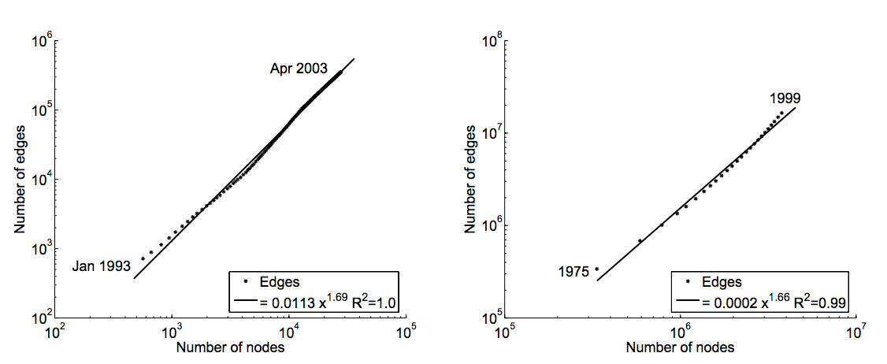
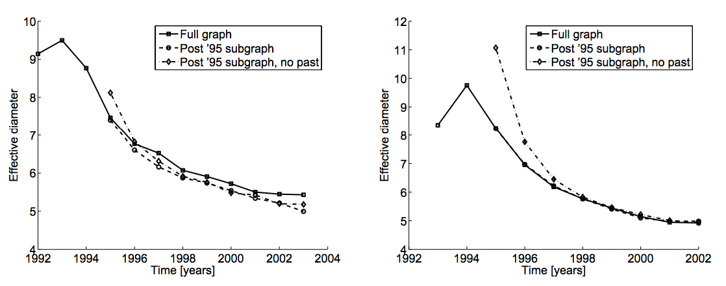
History of Social Network Analysis
Stanley Milgram. The small world problem. Psychology Today, 2(1):60–67, 1967.
2005: Network Evolution
“Most of graphs densify over time, with the number of edges growing superlinearly in the number of nodes.”
“The average distance between nodes often shrinks over time.”
Computational Social Science [Giles]
2012
J. Leskovec, J. Kleinberg, C. Faloutsos. Graphs over Time: Densification Laws, Shrinking Diameters and Possible Explanations. In KDD, 2005. Best Research Paper Award & Test of Time Award. Cited by 1492 (as of May 2016)
Computational Social Science [Lazer et al.]
2009
2009
Social Influence Analysis [Tang, Sun]
2007
Spread of Obesity, Happiness [Christakis, Fowler]
2005
Densification [Leskovec, Kleinberg, Faloutsos]
2003
Link Prediction [Liben-Nowell, Kleinberg]
Influence Maximization [Kempe, Kleinberg, Tardos]
2002
Community Detection [Girvan, Newman]
Stanley Milgram. The small world problem. Psychology Today, 2(1):60–67, 1967.
Scale Free [Barabási,Albert & Faloutsos et al.]
1999
Small World [Watts, Strogatz]
1998
Hubs & Authorities [Kleinberg]
1997
1995
Structural Hole [Burt]
1992
Dunbar’s Number [Dunbar]
Densification
1973
Weak Tie [Granovetter]
Shrinking Diameters
1967
Six Degrees of Separation [Milgram]
Notes:
Social influence
Information diffusions
1955, Two step of flow: katz lazarsfeld

Slide 23
History of Social Network Analysis
Stanley Milgram. The small world problem. Psychology Today, 2(1):60–67, 1967.
2007: Diffusion and Influence
Nicholas Christakis, James Fowler. The Spread of Obesity in a Large Social Network Over 32 Years. The New England Journal of Medicine 357 (4): 370–379, 2007. Cited by 3335 (as of May 2016)
Nicholas Christakis, James Fowler. The Collective Dynamics of Smoking in a Large Social Network. The New England Journal of Medicine 358 (21): 2249–2258, 2008. Cited by 1232 (as of May 2016)
James Fowler, Nicholas Christakis. The Dynamic Spread of Happiness in a Large Social Network. British Medical Journal 337 (768): a2338, 2009. Cited by 1178 (as of May 2016)
Computational Social Science [Giles]
2012
Computational Social Science [Lazer et al.]
2009
2009
Social Influence Analysis [Tang, Sun]
2007
Spread of Obesity, Happiness [Christakis, Fowler]
2005
Densification [Leskovec, Kleinberg, Faloutsos]
2003
Link Prediction [Liben-Nowell, Kleinberg]
Influence Maximization [Kempe, Kleinberg, Tardos]
2002
Community Detection [Girvan, Newman]
Stanley Milgram. The small world problem. Psychology Today, 2(1):60–67, 1967.
Scale Free [Barabási,Albert & Faloutsos et al.]
1999
Small World [Watts, Strogatz]
1998
“If the husband became obese, the likelihood that his wife would become obese increased by 37%.”
—by tracking 10,000+ people for 32 years
Hubs & Authorities [Kleinberg]
1997
1995
Structural Hole [Burt]
1992
Dunbar’s Number [Dunbar]
1973
Weak Tie [Granovetter]
1967
Six Degrees of Separation [Milgram]
Notes:
Social influence
Information diffusions
1955, Two step of flow: katz lazarsfeld

Slide 24

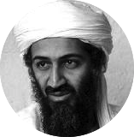





History of Social Network Analysis
Stanley Milgram. The small world problem. Psychology Today, 2(1):60–67, 1967.
2009: Social Influence Analysis
“Social influence is a prevalent, complex and subtle force that governs the dynamicsof all social networks.”
Computational Social Science [Giles]
2012
Jie Tang, Jimeng Sun, Chi Wang, and Zi Yang. Social Influence Analysis in Large-scale Networks. In KDD'09, pages 807-816. Top cited paper in KDD’09. Cited by 624 (as of April 2017)
Computational Social Science [Lazer et al.]
2009
2009
Social Influence Analysis [Tang, Sun]
2007
Spread of Obesity, Happiness [Christakis, Fowler]
2005
Densification [Leskovec, Kleinberg, Faloutsos]
2003
Link Prediction [Liben-Nowell, Kleinberg]
Influence Maximization [Kempe, Kleinberg, Tardos]
2002
Community Detection [Girvan, Newman]
Stanley Milgram. The small world problem. Psychology Today, 2(1):60–67, 1967.
Scale Free [Barabási,Albert & Faloutsos et al.]
1999
Politics
Small World [Watts, Strogatz]
1998
“How to quantify the social influences from different topics”
—Topical Affinity Propagation (TAP), an efficient model
Hubs & Authorities [Kleinberg]
1997
0.3
0.7
1995
Structural Hole [Burt]
0.1
0.74
0.2
0.4
1992
0.05
Dunbar’s Number [Dunbar]
0.5
1973
Weak Tie [Granovetter]
0.1
1967
Six Degrees of Separation [Milgram]
Notes:
Social influence
Information diffusions
1955, Two step of flow: katz lazarsfeld

Slide 25
History of Social Network Analysis
Stanley Milgram. The small world problem. Psychology Today, 2(1):60–67, 1967.
The Early 21st Century
More Computer & Data Scientists
Computational Social Science [Giles]
2012
Computational Social Science [Lazer et al.]
2009
2009
Social Influence Analysis [Tang, Sun]
2007
Spread of Obesity, Happiness [Christakis, Fowler]
2005
Densification [Leskovec, Kleinberg, Faloutsos]
2003
Link Prediction [Liben-Nowell, Kleinberg]
Influence Maximization [Kempe, Kleinberg, Tardos]
2002
Community Detection [Girvan, Newman]
Scale Free [Barabási,Albert & Faloutsos et al.]
1999
Small World [Watts, Strogatz]
1998
Hubs & Authorities [Kleinberg]
1997
1995
Structural Hole [Burt]
1992
Dunbar’s Number [Dunbar]
1973
Weak Tie [Granovetter]
1967
Six Degrees of Separation [Milgram]
The Late 20th Century:
Computer Science & Physics & Mathematics
The 20th Century: Sociology & Anthropology
Notes:
Social influence
Information diffusions
1955, Two step of flow: katz lazarsfeld

Slide 26
Computational Social Science
Computational Social Science [Giles]
2012
Computational Social Science [Lazer et al.]
2009
Stanley Milgram. The small world problem. Psychology Today, 2(1):60–67, 1967.
Spread of Obesity, Smoking, Happiness
[Christakis, Fowler]
2009-
2007
Spread of Obesity, Smoking, Happiness
[Christakis, Fowler]
2009-
2007
“A field is emerging that leverages the capacity to collect and analyze data at a scale that may reveal patterns of individual and group behaviors.”
2005
2005
Densification [Leskovec, Kleinberg, Faloutsos]
2003
2003
Link Prediction [Liben-Nowell, Kleinberg]
Influence Maximization [Kempe,Kleinberg,Tardos]
David Lazer, Alex Pentland, Lada Adamic, Sinan Aral, Alber-Laszlo Barabasi, et al. from Departments of Sociology, Computer Science, Physics, Business, Government, etc. at Harvard, MIT, Northeastern, Northwestern, Columbia, Cornell, etc.
2002
2002
Community Detection [Girvan, Newman]
1999
Scale Free [Barabási,Albert & Faloutsos et al.]
1999
Scale Free [Barabási,Albert & Faloutsos et al.]
1998
Small World [Watts, Strogatz]
Small World [Watts, Strogatz]
1998
Computational Models
Big Data Algorithms
Sociology, Physics, Psychology, Business, Management, et al.
Hubs & Authorities [Kleinberg]
1997
Hubs & Authorities [Kleinberg]
1997
Interdisciplinary
Structural Hole [Burt]
1995
1995
Structural Hole [Burt]
1992
Dunbar’s Number [Dunbar]
1992
Dunbar’s Number [Dunbar]
1973
1973
Weak Tie [Granovetter]
Weak Tie [Granovetter]
1967
1967
Six Degrees of Separation [Milgram]
Six Degrees of Separation [Milgram]
David Lazer et al. Computational Social Science. Science 2009.
James Giles. Computational Social Science: Making the Links. Nature 2012.
Notes:
Social influence
Information diffusions
1955, Two step of flow: katz lazarsfeld

Slide 27
History of Social Network Analysis
Computational Social Science [Giles]
2012
Computational Social Science [Lazer et al.]
2009
2009
Social Influence Analysis [Tang, Sun]
2007
Spread of Obesity, Happiness [Christakis, Fowler]
2005
Densification [Leskovec, Kleinberg, Faloutsos]
2003
Link Prediction [Liben-Nowell, Kleinberg]
Influence Maximization [Kempe, Kleinberg, Tardos]
2002
Community Detection [Girvan, Newman]
Scale Free [Barabási,Albert & Faloutsos et al.]
1999
Small World [Watts, Strogatz]
1998
Hubs & Authorities [Kleinberg]
1997
1995
Structural Hole [Burt]
1992
Dunbar’s Number [Dunbar]
1973
Weak Tie [Granovetter]
1967
Six Degrees of Separation [Milgram]
Notes:
Social influence
Information diffusions
1955, Two step of flow: katz lazarsfeld

Slide 28

Roadmap
data
User
Tie
Structure
Heterogeneous
Micro
Macro
tie
Dynamic
Influence
- User Modeling
- Demographics
- Social Role
- Social Tie/Link
- Homophily
- Social Influence
- Triad Formation
- Community
- Group Behavior
Big&Big
social
Social Theories
Graph Theories
BIG Networks

Slide 29
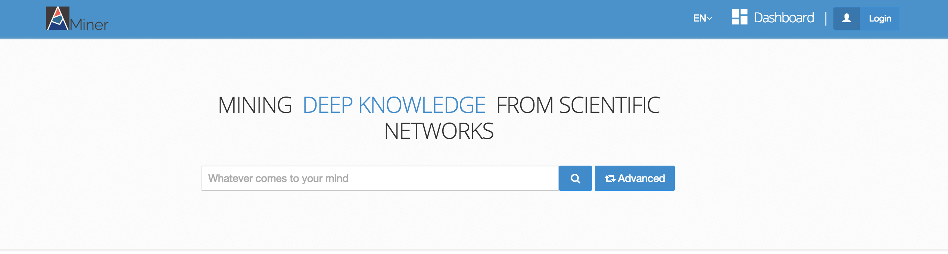
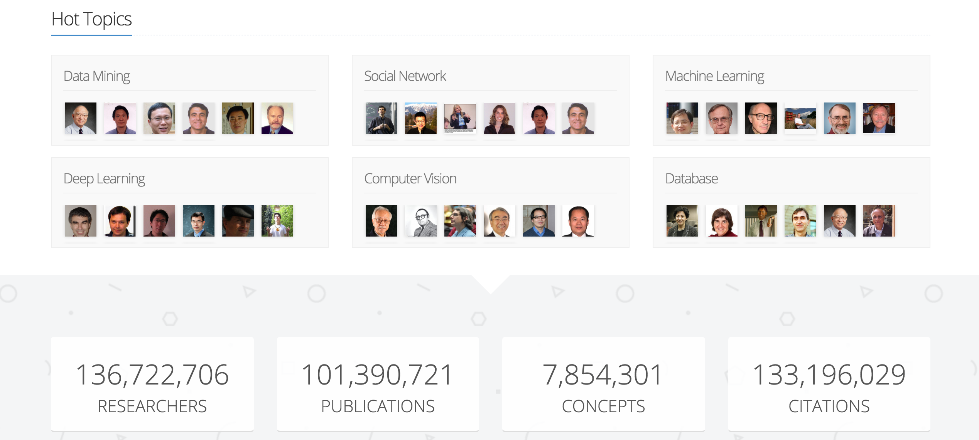
Example in my talk—AMiner.org
An author-centric academic search and mining system

Slide 30
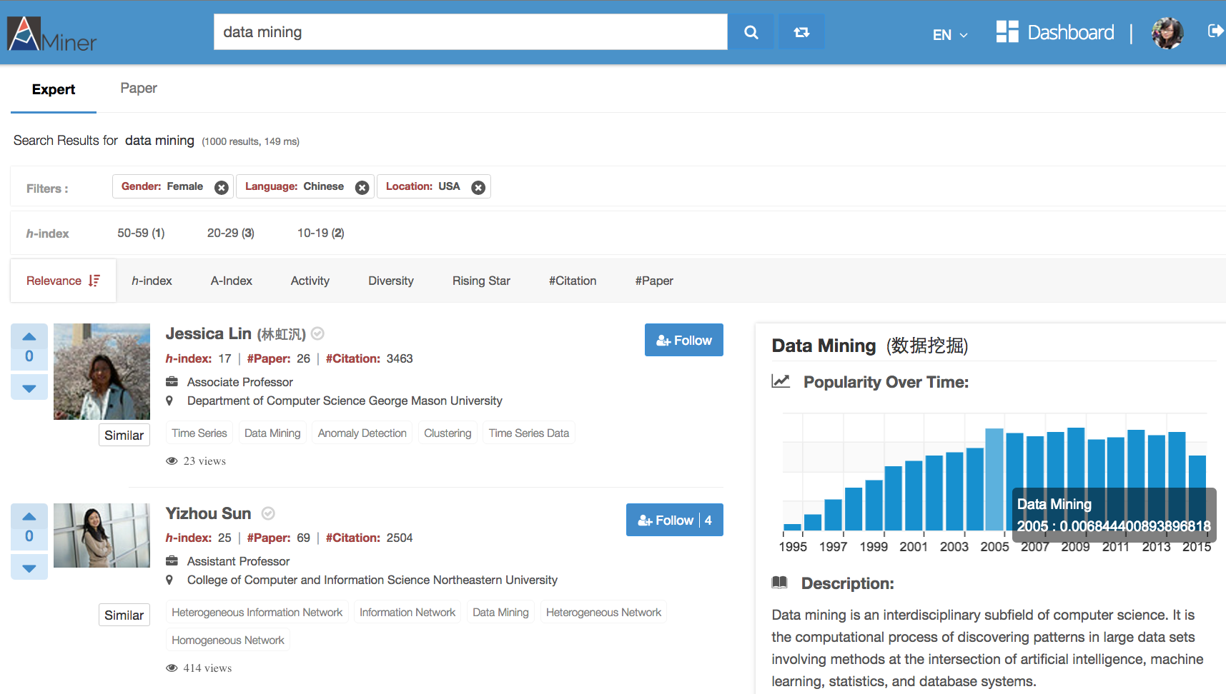
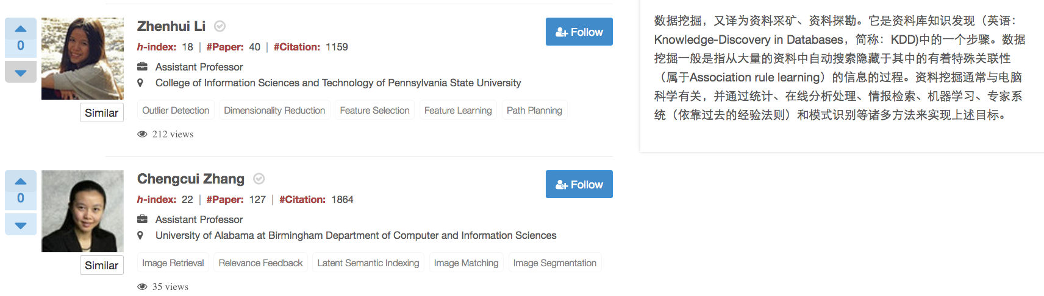
Expert.ai
Find female experts from USA working on “Data Mining” and who can speak “Chinese”?
Author modeling: demographics, interests, etc.
Network analysis: collaborative network and knowledge graph
Notes:
P40: 这是为科研人员提供的一个典型服务：智能专家搜索。例如寻找在“美国”做“数据挖掘”研究的“华裔女性”专家，可以得到如图所示的结果。

Slide 31
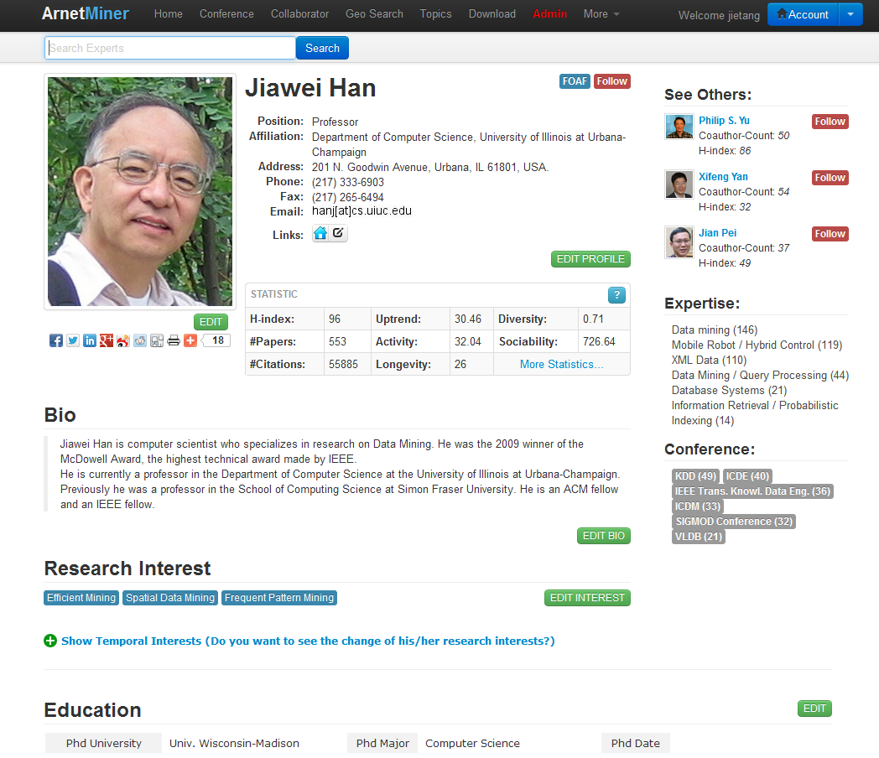
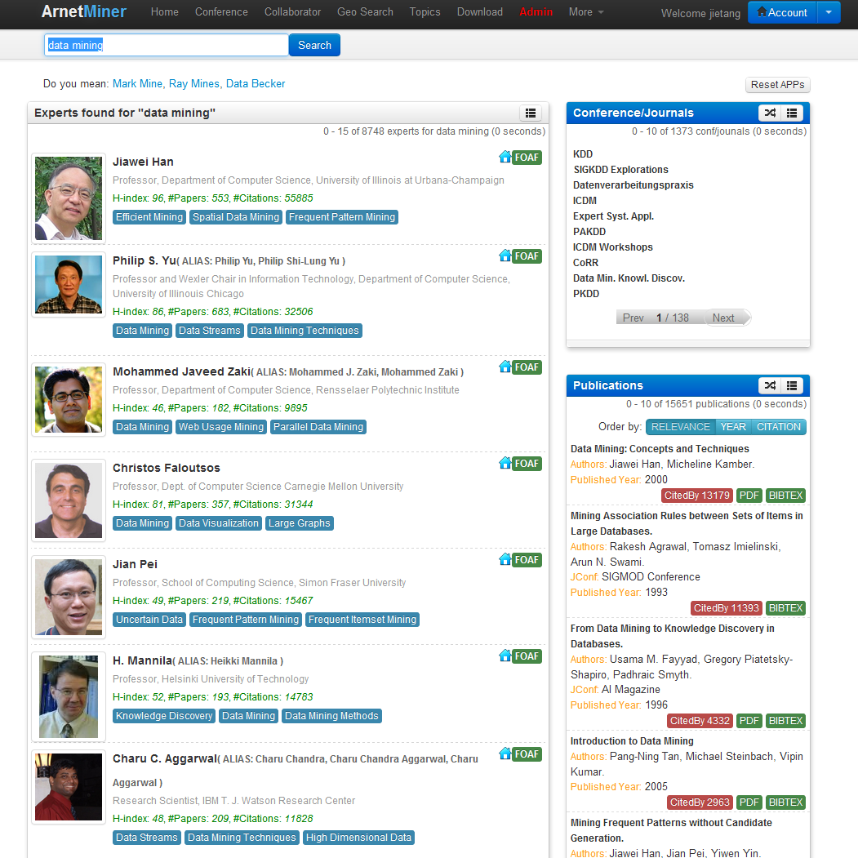
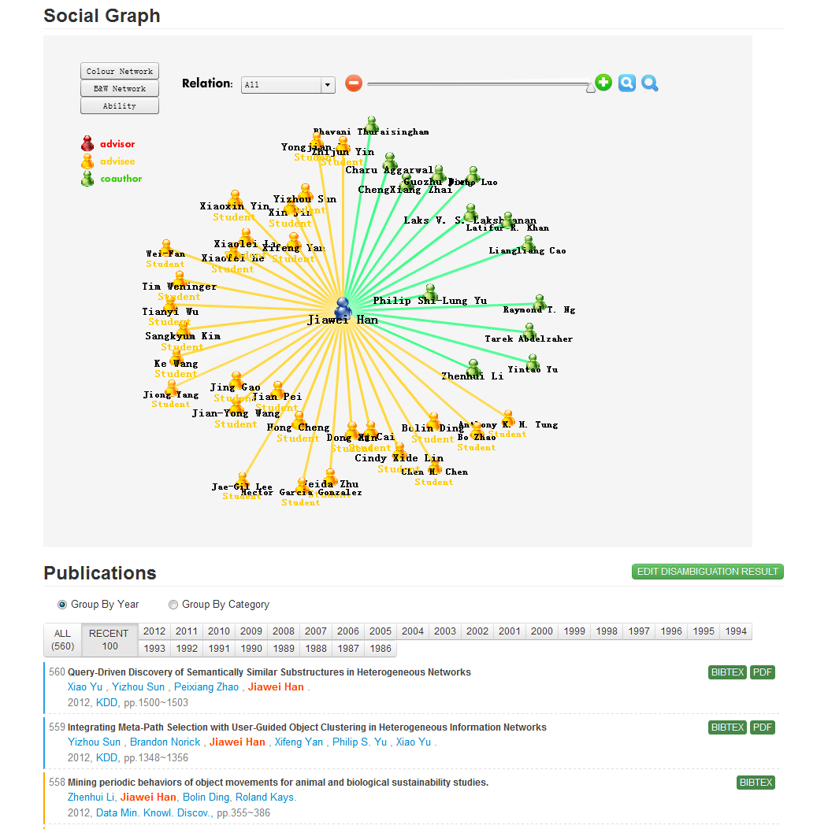
Example in my talk—AMiner.org
Academic search and mining system
  Online since 2006
  >136 million researcher profiles
  >201 million publication papers
  >341 million requests
  100K IP access from 170 countries per month
Revealing social patterns from scientific networks…
Notes:
基于前面的理论研究成果，我们自主研发了研究者社会网络挖掘与搜索系统Arnetminer，系统从2006年开始在线运行，收集了大量的学术数据，到目前为止，系统累积2.35TB数据，有超过1.3亿次用户访问，每月就用来自170个国家的10万用户访问。

Slide 32
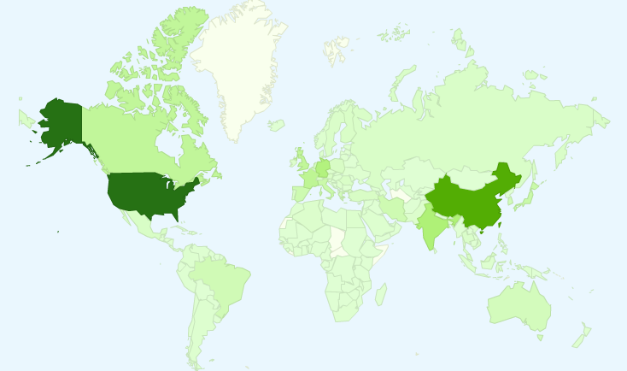
User Distribution
  8.32 million IP from 220 countries/regions
Notes:
截止目前，Arnetminer系统已有来自200个国家和地区277万独立IP的访问，这里列出了访问量前10的国家。

Slide 33
User Distribution
  8.32 million IP from 220 countries/regions
Top 10 countries
1. USA 6. Canada
2. China 7. Japan
3. Germany 8. Spain
4. India 9. France
5. UK 10. Italy
Notes:
截止目前，Arnetminer系统已有来自200个国家和地区277万独立IP的访问，这里列出了访问量前10的国家。

Slide 34
Thank you！
Collaborators: John Hopcroft, Jon Kleinberg, Chenhao Tan (Cornell)
Jiawei Han (UIUC), Philip Yu (UIC)
Jian Pei (SFU), Hanghang Tong (ASU)
Tiancheng Lou (Google&Baidu), Jimeng Sun (GIT)
Wei Chen, Ming Zhou, Long Jiang, Chi Wang, Yuxiao Dong (Microsoft)
Yutao Zhang, Jing Zhang, Zhanpeng Fang, Zi Yang, Sen Wu, etc. (THU)
  Jie Tang, KEG, Tsinghua U, http://keg.cs.tsinghua.edu.cn/jietang
  Download all data & Codes, http://arnetminer.org/data
  http://arnetminer.org/data-sna

Slide 35
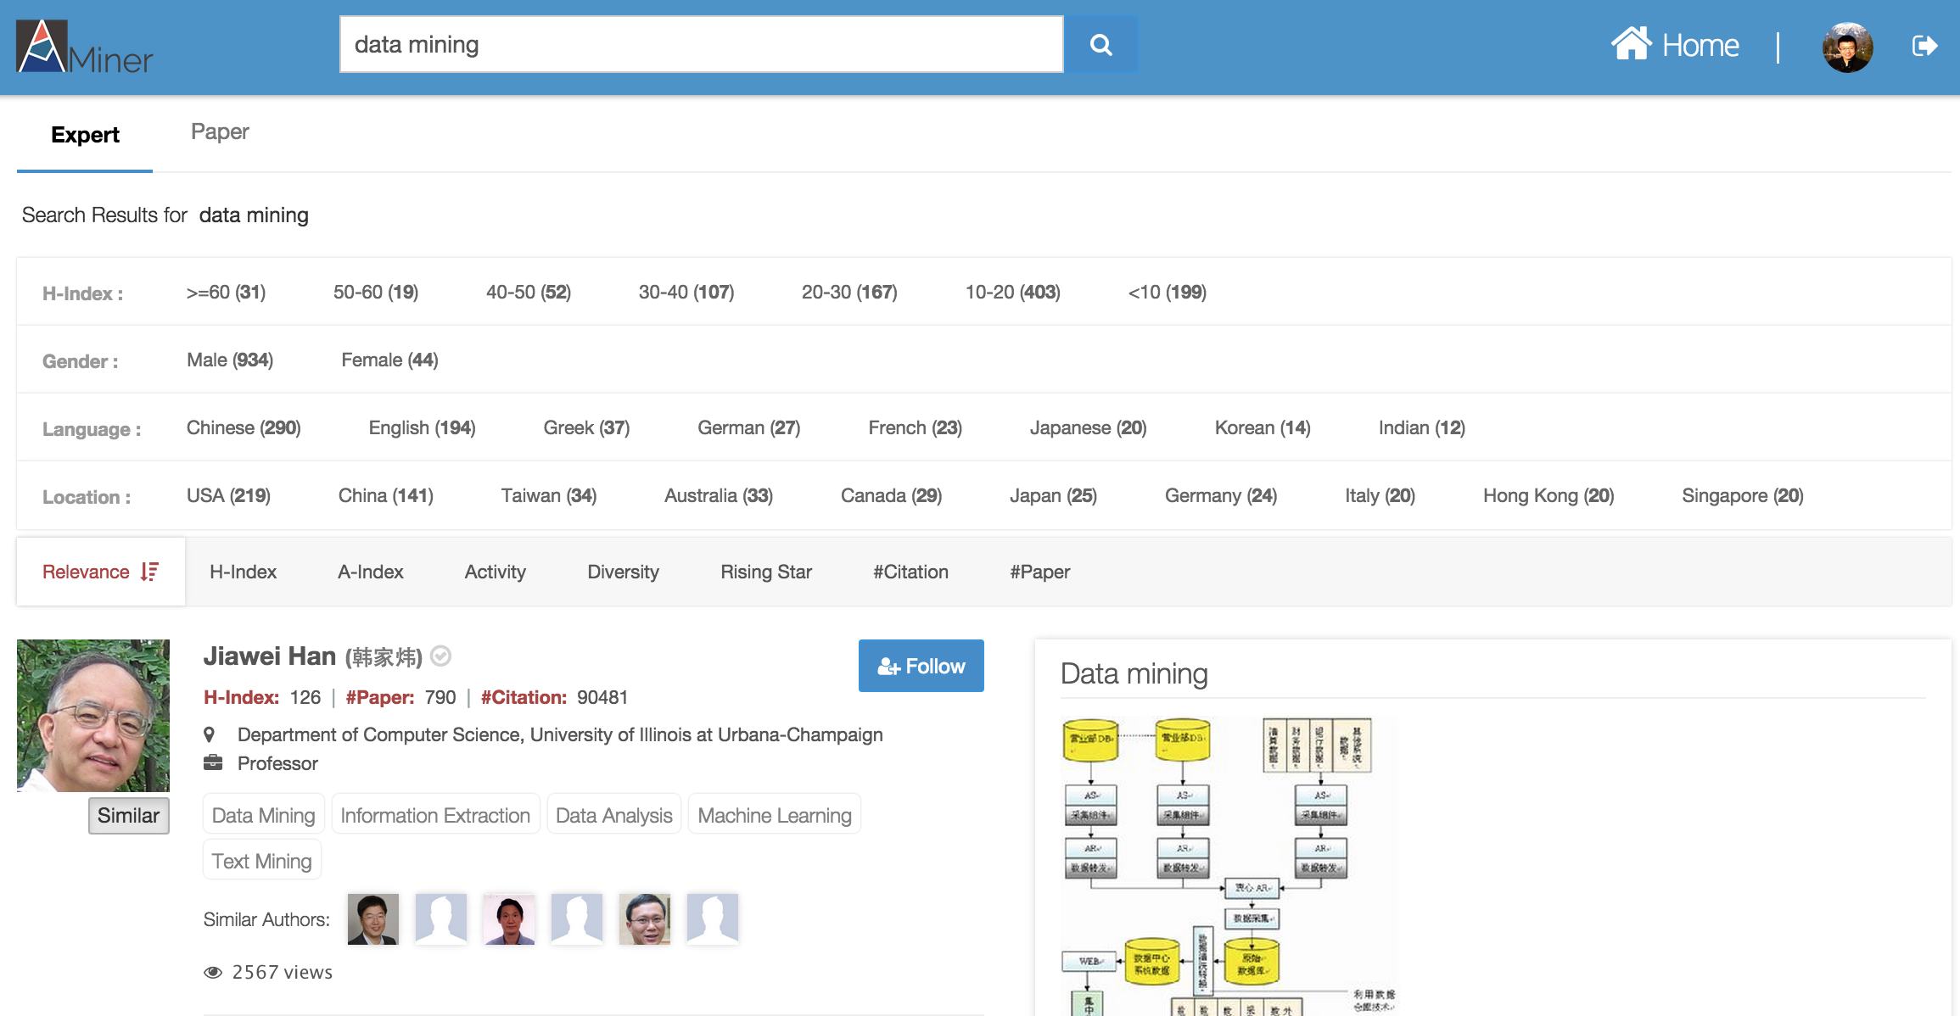
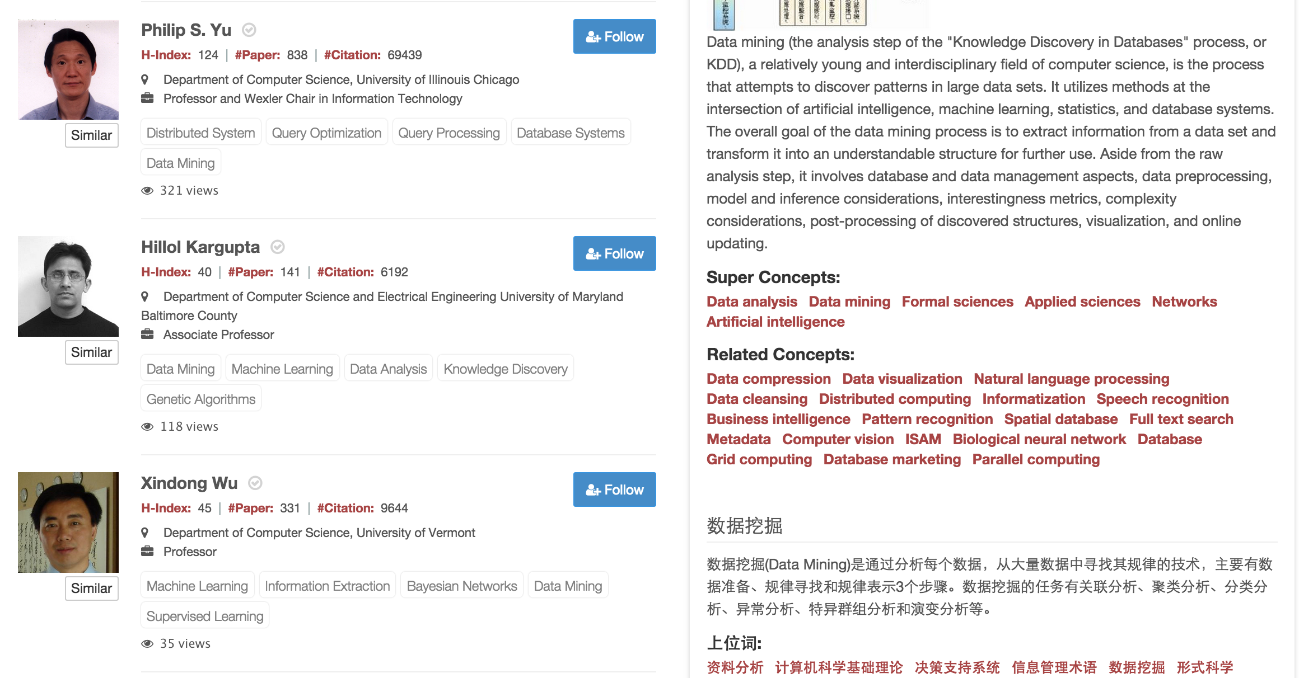
Expert
Search
Demographics: gender, language, location, etc.
Finding experts,
for “data mining”
Knowledge about
“data mining”
Similar Authors

Slide 36
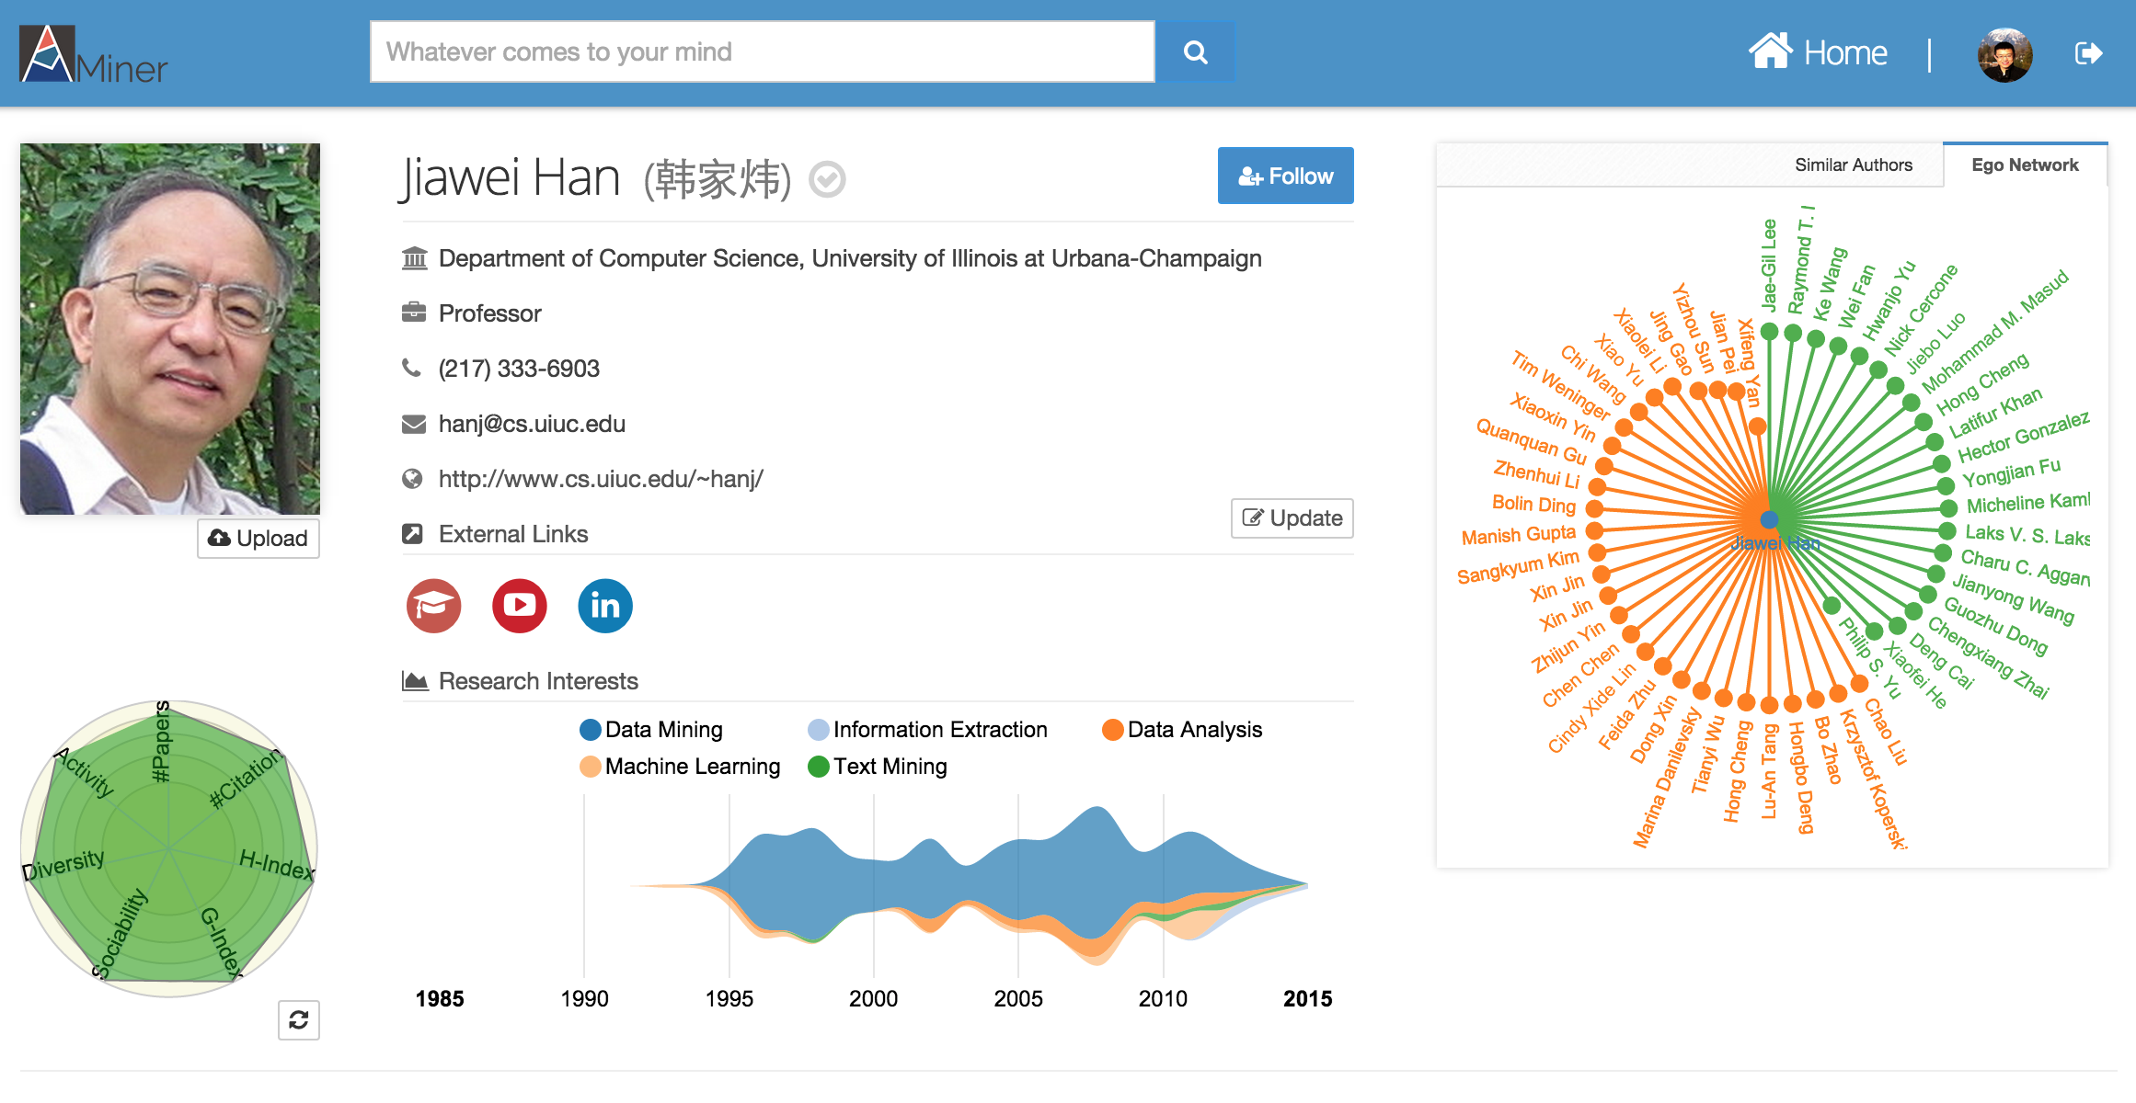

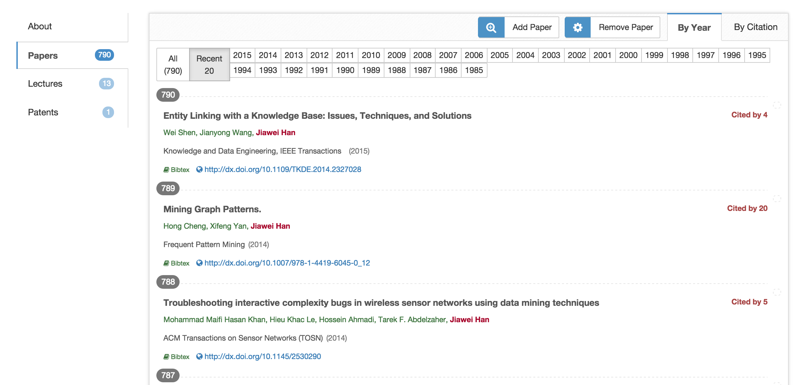
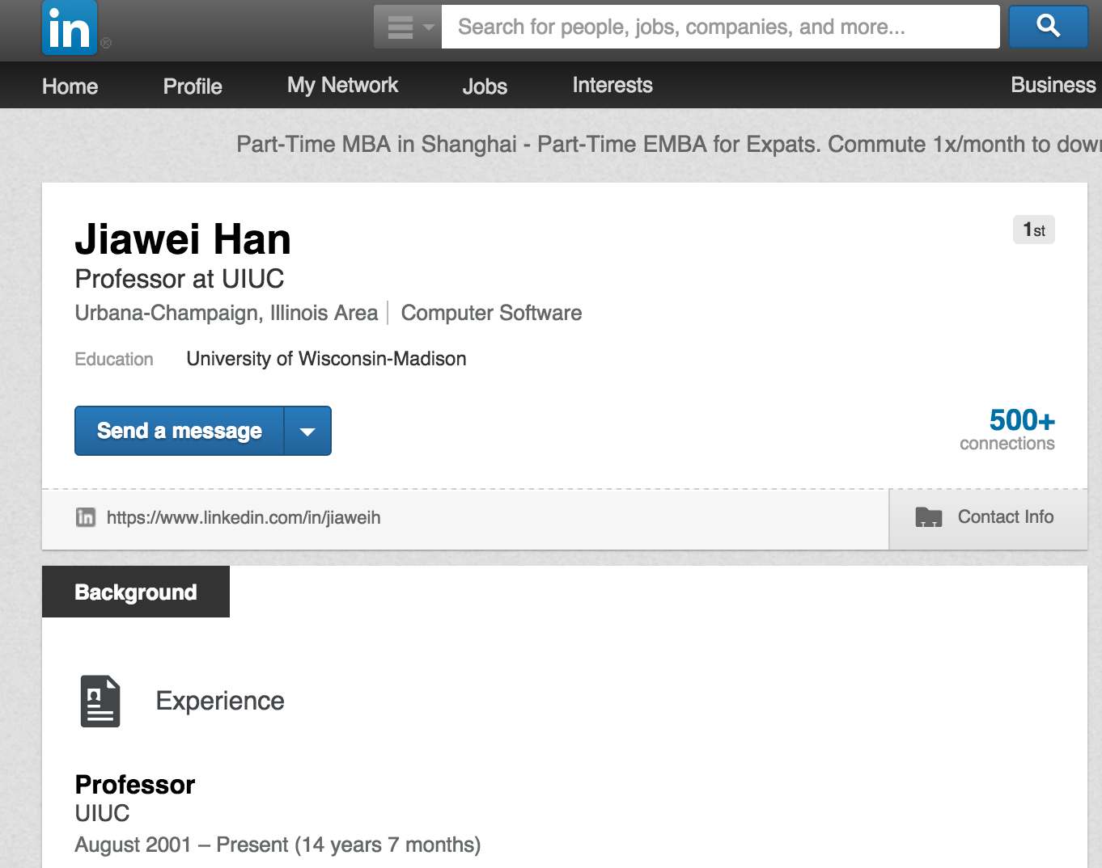
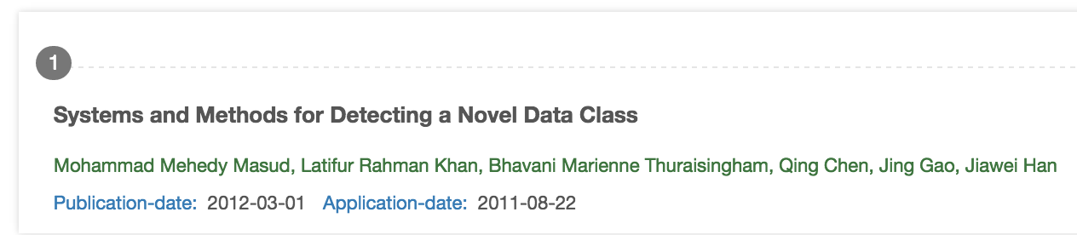
Researcher
Profile
Basic Info.
Research Interests
Citation Statistics
Ego Network

Slide 37

Examples – Expert search
When starting a
Work on a new research topic;
Or brainstorming for novel ideas.
Researcher
Who are experts in this field?
What are the top conferences in the field?
What are the best papers?
What are the top research labs?
?

Slide 38


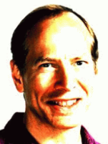

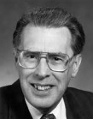




Examples – Collaboration Recommendation
Data Mining
Theory
Large Graph
?
Heterogeneous Network
Automata theory
Graph
Theory
Social
Network
Complexity Theory
Notes:
Interdisciplinary collaborations have generated huge impact, for example,
51 (>1/3) of the KDD 2012 papers are result of cross-domain collaborations between graph theory, visualization, economics, medical inf., DB, NLP, IR
Research field evolution
Describe the problem
First, sparse connection, compared to traditional collaborations within a domain, cross-domain collaborations are very rare. partly because it is difficult for an outsider to find the right collaborator in the field that one does not know. This also makes it challenging to directly use a supervised learning approach due to the lack of training samples.
Second, complementary expertise, cross-domain collaborators often have different expertise and interest; For example, data mining researchers can easily identify who they want to work with in the data mining field, because they are familiar with the sub topics. However, for a cardiologist who wants to apply data mining techniques to predict heart failures, it will be difficult for her to find the right collaborators in data mining. Because these two fields (cardiology and data mining) are totally different with different terminology and problems. It is very difficult for one from cardiology to identify the right topics in data mining to look for collaborators.
Third, topic skewness, not all topics are relevant for crossdomain collaborations. In fact, in our study, only less than one-tenth of all possible topics pairs across domains have collaborations. Therefore, for the task of cross-domain collaboration recommendation, we should focus on better modeling those topics with high probability of having cross-domain collaborations

Slide 39
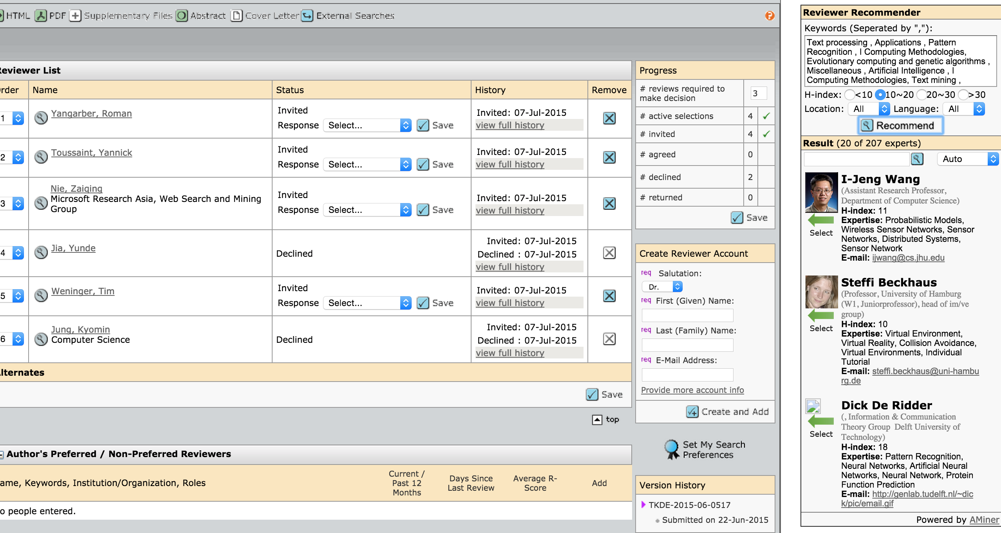
Examples – Reviewer Suggestion
Integration with ScholarOne: Find the extension—reviewer recommender
—from Chrome Web Store
ScholarOne is a submission management system used by many journals such as
IEEE Transactions and ACM Transactions.

